Slide 1
February 18, 2016

Slide 2
AGENDA:
Strong Workforce Trailer Bill
Data Unlocked Initiative
Consortium Input for 2016-2017
Chancellor’s Office Update
Post-meeting: CCCAOE Roundtable

Slide 3
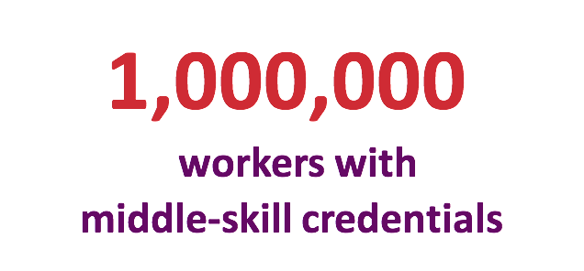

Slide 5
Strong Taskforce Trailer Bill
Regional
Planning
Unit

Slide 6
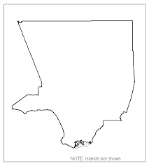
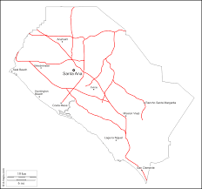
What Does That Mean For LAOCRC?
Los Angeles County
Orange County

Slide 7
Strong Workforce Program
State of Things - General Charge
Definitions
Alignment & Long Term Planning
2016-2017 Details
2017-2018 Details
Accountability

Slide 8
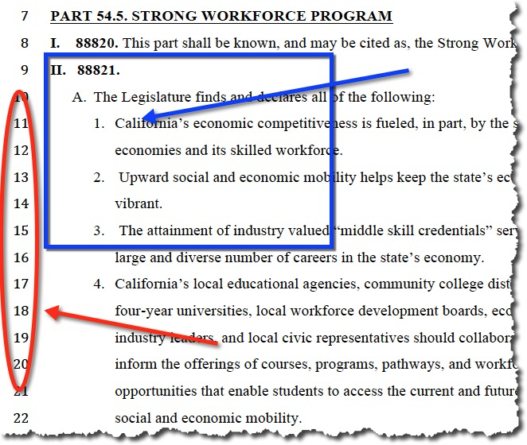
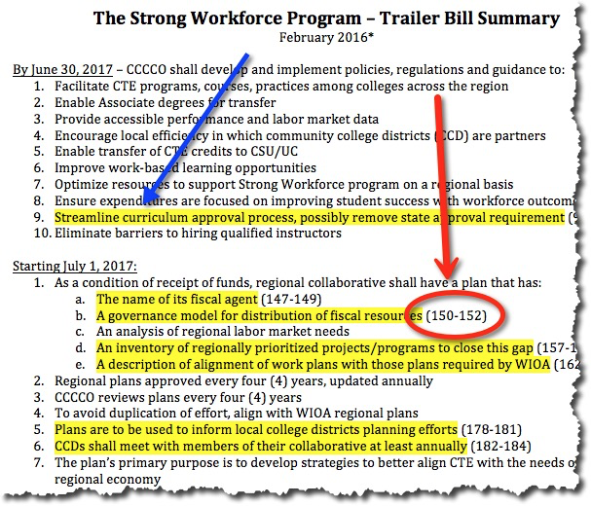
Strong Taskforce Trailer Bill

Slide 9
CTE Data Unlocked - Lori Sanchez
from Taskforce work - Develop student outcomes and labor market information
up to $50,000 funding per college for:
Training (college leaders)
Technical assistance
CTE Outcomes Survey
Develop a suite of tools to support the integration of these data sources into college processes

Slide 10
Provide “super-user” trainings (college-based practitioners)
Create reports synthesizing student outcomes and LMI to support regional planning (regional decision)
Regional meetings to discuss regional planning
CTE Data Unlocked - Lori Sanchez

Slide 11
Consortium Input
Nick Kremer & Julie Pehkonen

Slide 12
Chancellor’s Office Update
Perkins
Reauthorization
2017-18 Funding
District Certification Form
http://extranet.cccco.edu/Divisions/WorkforceandEconDev/CareerEducationPractices/Memos.aspx
Quarterly Reporting
WIOA
Plan Update

Slide 13
Chancellor’s Office Update
Strong Workforce Program Trailer Bill
Why Established
Guiding Principles
Policies and Guidance
Workforce Economic Development Division RFAs
http://extranet.cccco.edu/Divisions/WorkforceandEconDev/WEDDRFAs.aspx
IDRCs (SB1402)
Nursing
CTE Data Unlocked

Slide 14
Chancellor’s Office Update
OTHER
Division of Educational Services RFA
Basic Skills and Student Outcomes Transformation Program
CLICK HERE to see the Community College Basic Skills and Student Outcome Transformation Program RFA.
Educational Opportunities Center Program
CLICK HERE for More Information on the Education Opportunity Center Funding Opportunity.
JASPAC Webinar on STEM and STEAM Education and Employment
SB1070 Career Technical Education Pathways Program Grant

Slide 15
CCCAOE Roundtable Today
Join your CCCAOE LA/OC Regional Vice President from 11:30a.m.-12:00p.m. in Crystal C for a discussion of:
CCCAOE 2015-16 priorities, and
Opportunities for involvement

Slide 16
March Program Approval Cycle
Apps Due - Tuesday, Mar. 1, 2016
Voting Window - Mar. 8-15
PA Meeting - Mar. 17, 8:30 - 9:30
March Consortia Meeting
Thursday, March 17, 2016
DOW & LB 2.0
9:45 - 11:15

